Slide 1
Jazz.exe.py
Griffin Edwards, Eyal Sharon, Justin Millette

Slide 2
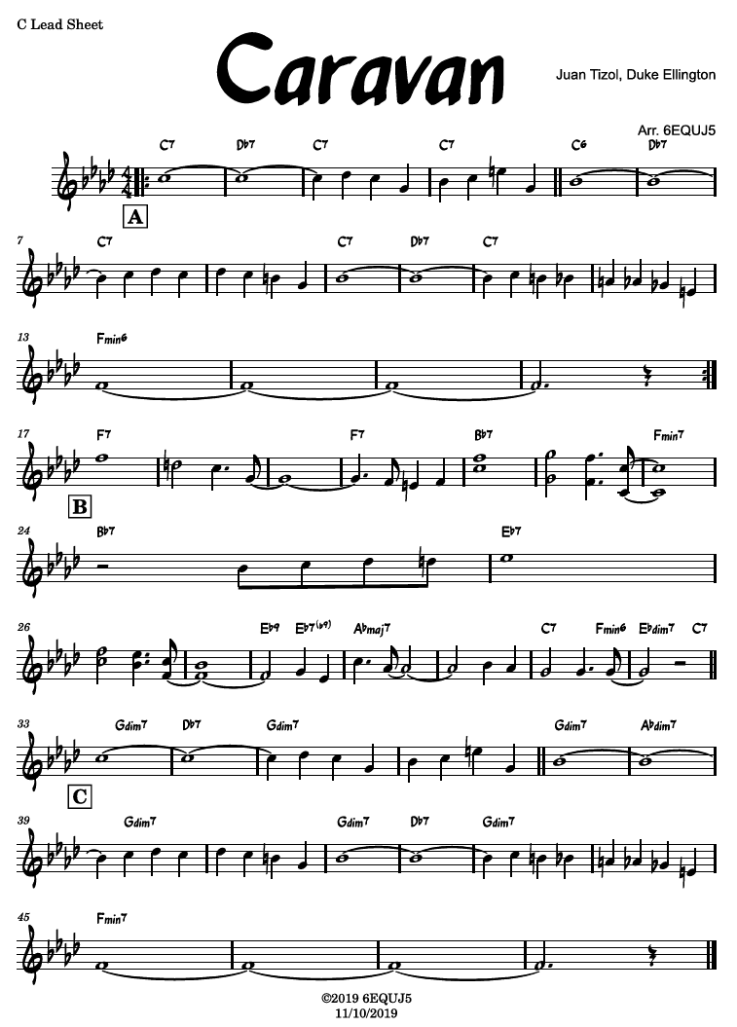
General Idea
Take in a lead sheet as a .musicxml file, then play that tune as a jazz combo.

Slide 3
General Idea
Take in a lead sheet as a .musicxml file, then play that tune as a jazz combo.
Parse lead sheet to get melody and chords

Slide 4
General Idea
Take in a lead sheet as a .musicxml file, then play that tune as a jazz combo.
Parse lead sheet to get melody and chords
Melody
Chords

Slide 5
General Idea
Take in a lead sheet as a .musicxml file, then play that tune as a jazz combo.
Assign melody to horn part
Melody
Generate piano comping
Chords
Generate walking bassline

Slide 6
General Idea
Take in a lead sheet as a .musicxml file, then play that tune as a jazz combo.
Assign melody to horn part
Melody
The “head”
Melody from lead sheet
Generated piano comping
Generated walking bassline
Generate piano comping
Chords
Generate walking bassline

Slide 7
General Idea
Take in a lead sheet as a .musicxml file, then play that tune as a jazz combo.
Form
The “head”
Melody from lead sheet
Generated piano comping
Generated walking bassline
Solo sections
Right hand piano
Saxophone solo
Piano and sax trades
The head, again
Melody from lead sheet
Generated piano comping
Generated walking bassline

Slide 8
Bassline: Bucketed Markov 1-Chains
Goal: Generate walking bassline from given chord.
Walking basslines move in short steps frequently, and long jumps more infrequently.
Markov Chains are perfect for this!
…but finding data for that is challenging.
Notes:
Walking basslines move a lot, and want to move in short steps more than in long jumps. But both are acceptable.

Slide 9
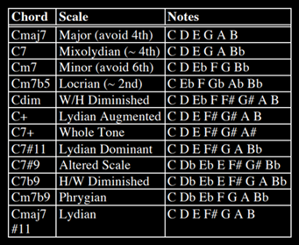
Bassline: Bucketed Markov 1-Chains
Idea: Generate Markov Chain matrices for each chord, based on the given chord quality (C7, Cm, Cmaj7 add #11)
GenJam paper gave us a good starting point of what notes we should play over a given chord (Biles, 1994):
 | C | D | E | G | A | B
C
D
E
G
A
B
Let’s look at Cmaj7
Notes:
Walking basslines move a lot, and want to move in short steps more than in long jumps. But both are acceptable.

Slide 10
Bassline: Bucketed Markov 1-Chains
Looking at Cmaj7, we see that we “should” play C, D, E, G, A, and B over this chord. We also note that Cmaj7 is built up of the notes C, E, G, and B. (This generalizes to any maj7 chord.)
So we can build the outline of our matrix:
 | C | D | E | G | A | B
C
D
E
G
A
B
Notes:
Walking basslines move a lot, and want to move in short steps more than in long jumps. But both are acceptable.

Slide 11
Bassline: Bucketed Markov 1-Chains
A walking bassline can choose the same note, just rarely.
 | C | D | E | G | A | B
C | .05
D |  | .05
E |  |  | .05
G |  |  |  | .05
A |  |  |  |  | .05
B |  |  |  |  |  | .05
Notes:
Walking basslines move a lot, and want to move in short steps more than in long jumps. But both are acceptable.

Slide 12
Bassline: Bucketed Markov 1-Chains
The “bucket” is like a bag of marbles that we draw from, where each marble represents a note to move to.
There are different buckets for each “previous” note (each row)
 | C | D | E | G | A | B
C | .05
D |  | .05
E |  |  | .05
G |  |  |  | .05
A |  |  |  |  | .05
B |  |  |  |  |  | .05
Previous note: C
Choose from: [ ]
Notes:
Walking basslines move a lot, and want to move in short steps more than in long jumps. But both are acceptable.

Slide 13
Bassline: Bucketed Markov 1-Chains
The “bucket” is like a bag of marbles that we draw from, where each marble represents a note to move to.
There are different buckets for each “previous” note (each row)
Each note must have at least a chance of being selected, so add a marble for each.
Previous note: C
Choose from: [D E G A B]
 | C | D | E | G | A | B
C | .05
D |  | .05
E |  |  | .05
G |  |  |  | .05
A |  |  |  |  | .05
B |  |  |  |  |  | .05
Notes:
Walking basslines move a lot, and want to move in short steps more than in long jumps. But both are acceptable.

Slide 14
Bassline: Bucketed Markov 1-Chains
It’s nice to alternate between chord tones and non-chord tones, but this isn’t that strict. We add a marble for each non-chord tone in a chord tone’s bucket, and do the converse as well. So for C, we add a marble for D and A
Previous note: C
Choose from: [D D E G A A B]
 | C | D | E | G | A | B
C | .05
D |  | .05
E |  |  | .05
G |  |  |  | .05
A |  |  |  |  | .05
B |  |  |  |  |  | .05
Notes:
Walking basslines move a lot, and want to move in short steps more than in long jumps. But both are acceptable.

Slide 15
Bassline: Bucketed Markov 1-Chains
Close motion is better! So add another marble for each note adjacent to where we just were.
Previous note: C
Choose from: [D D D E G A A B]
 | C | D | E | G | A | B
C | .05
D |  | .05
E |  |  | .05
G |  |  |  | .05
A |  |  |  |  | .05
B |  |  |  |  |  | .05
Notes:
Walking basslines move a lot, and want to move in short steps more than in long jumps. But both are acceptable.

Slide 16
Bassline: Bucketed Markov 1-Chains
Now we convert these marbles into probabilities:
Previous note: C
Choose from: [D D D E G A A B]
Next note: D?
Choose from: [D D D E G A A B] = 3/8
Next note: E?
Choose from: [D D D E G A A B] = 1/8 and so on…
 | C | D | E | G | A | B
C | .05
D |  | .05
E |  |  | .05
G |  |  |  | .05
A |  |  |  |  | .05
B |  |  |  |  |  | .05
Notes:
Walking basslines move a lot, and want to move in short steps more than in long jumps. But both are acceptable.

Slide 17
Bassline: Bucketed Markov 1-Chains
Now we convert these marbles into probabilities, and multiply by .95 because of the 5% chance of choosing the same note again:
Previous note: C
Choose from: [D D D E G A A B]
 | C | D | E | G | A | B
C | .05 | 0.35625 | 0.11875 | 0.11875 | 0.23750 | 0.11875
D |  | .05
E |  |  | .05
G |  |  |  | .05
A |  |  |  |  | .05
B |  |  |  |  |  | .05
Notes:
Walking basslines move a lot, and want to move in short steps more than in long jumps. But both are acceptable.

Slide 18
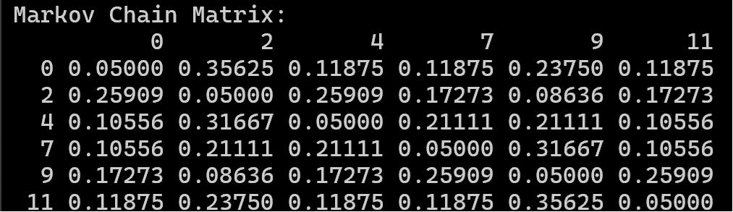
Bassline: Bucketed Markov 1-Chains
We repeat this for each row, and then we’re done!
Notes:
Walking basslines move a lot, and want to move in short steps more than in long jumps. But both are acceptable.

Slide 19
Bassline: Bucketed Markov 1-Chains
We repeat this for each row, and then we’re done!
We repeat this entire process for each chord quality.
Notes:
Walking basslines move a lot, and want to move in short steps more than in long jumps. But both are acceptable.

Slide 20
Piano Accompaniment: Monte Carlo rhythm selection
Iterate over the chords being played:
Generate a Monte Carlo rhythm that spans a given chord
Fill each chord-space with valid notes and rests
Identify note options to combine for an accompaniment chord
Include notes based on weights for certain intervals
Map notes and rests to Monte Carlo rhythm
Adjust # of attacks based on short/long rhythm length
Notes:
Talk about this a lot

Slide 21
Solos: Split Genetic Algorithm with Correctness/Closeness Scoring
Goal: Generate interesting piano and saxophone solos that fit over the chords, and that sound like they fit in the standard.
Genetic algorithms are good for this, as they cover a lot of solution space
Defining a good fitness function and new mutations are the hard (interesting) parts

Slide 22
Chromosome design
Split the head up into approximately 4 measure phrases
Each phrase becomes a chromosome, each chromosome has one gene per eighth note
Each gene can be a rest or a pitch
Initial population selects from [rest, notes_in_scale].
If a rest is selected, the next few genes also become rests to minimize choppiness
notes_in_scale determined from the table in the GenJam paper, combined with our own knowledge of jazz theory

Slide 23
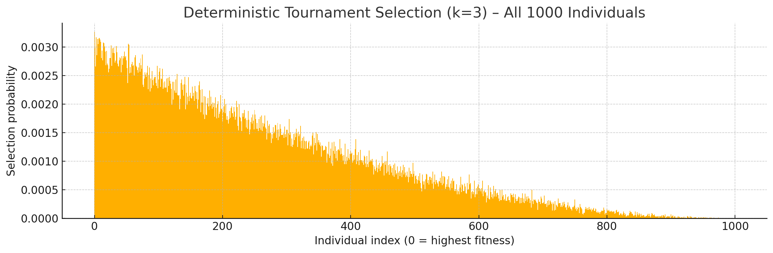
Genetic Algorithm Mechanics
Initial population size of 1000
Parent selection is done with deterministic tournament selection
(randomly select 3 individuals, then take the best of them)
Elitism brings the top few chromosomes from the previous generation into the next
We also use a local hill-climb function to make every new chromosome just a bit better (it makes one random gene a chord tone if it isn’t already one)

Slide 24
Mutations
Mostly use crossover to make a new chromosome, but not always
Random mutation happens on a gene-by-gene basis
We select from the same choices as the initial population generation
New “chord-tone-rescue” mutation replaces all non-chord tones with random chord tones
New “solo-chunk” mutation takes a chunk of the melody and inserts it into the solo
New “quote-self” mutation grafts in a chunk from a previously completed phrase

Slide 25
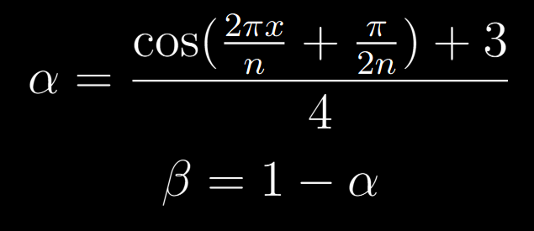
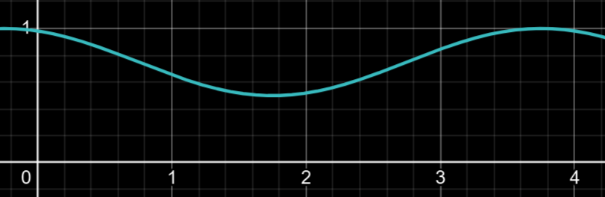
Fitness Function
Fitness score = α * closeness score + β * correctness score
For each split x, given n splits in total,

Slide 26
Closeness and Correctness
Each score lies in [0, 1]
Closeness scores are based on how similar the chromosome is to the melody, determined by pitch, interval, and quantity of attacks
Correctness scores are a bit more complex:
Rests, chord tones, melody notes, repeating the notes a bit are good
Stepwise/small motion is good, but that fades as more appear in a row
Big leaps are bad, but not as bad for piano
Huge leaps are bad for all instruments and even worse for sax
Lots of long notes is bad so we prioritize having a couple but not too many
Too many rests is bad, but too few is also bad
Too many attacks is bad, but too few is also bad (depends on instrument)
This is where a lot of dials exist for tweaking the output

Slide 27
Trading
Alternating instruments play for some amount of time
We implemented a solo section that trades between the piano and saxophone players
After the first trade, the closeness function instead applies to the last four bars played, so the solos build off of one another

Slide 28
Demo!

Slide 29
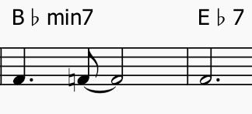
Piano Accompaniment: Monte Carlo rhythm selection
Iterate over the chords being played:
Generate a Monte Carlo rhythm that spans a given chord
4.0 = [0.5, 2, 1, 0.5]
Notes:
Walking basslines move a lot, and want to move in short steps more than in long jumps. But both are acceptable.

Slide 30
Piano Accompaniment: Monte Carlo rhythm selection
Iterate over the chords being played:
Generate a Monte Carlo rhythm that spans a given chord
Fill each chord-space with valid pitches and rests
4.0 = [0.5, 2, 1, 0.5]
Notes:
Walking basslines move a lot, and want to move in short steps more than in long jumps. But both are acceptable.

Slide 31
Piano Accompaniment: Monte Carlo rhythm selection
Chord: Bb m7:
Notes:
[0, 3, 7, 10],
Probs:
0 : 0
3,4 : 0.9
7 : 0.25
10,11: 0.9
ELSE : 0.6
Iterate over the chords being played:
Generate a rhythm that spans a given chord
Fill each chord-space with valid pitches and rests
4.0 = [0.5, 2, 1, 0.5]
Notes:
Walking basslines move a lot, and want to move in short steps more than in long jumps. But both are acceptable.

Slide 32

Piano Accompaniment: Monte Carlo rhythm selection
Chord: Bb m7:
Notes:
[0, 3, 7, 10],
Probs:
0 : 0
3,4 : 0.9
7 : 0.25
10,11: 0.9
ELSE : 0.6
Iterate over the chords being played:
Generate a rhythm that spans a given chord
Fill each chord-space with valid pitches and rests
4.0 = [0.5, 2, 1, 0.5]
Melody
Piano
Notes:
Walking basslines move a lot, and want to move in short steps more than in long jumps. But both are acceptable.

Slide 33
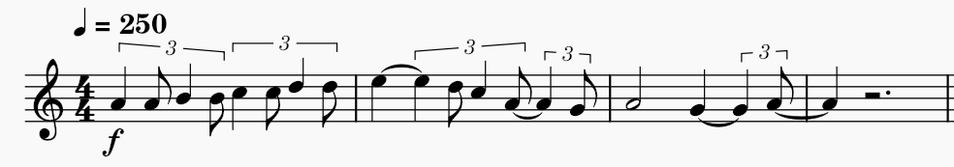
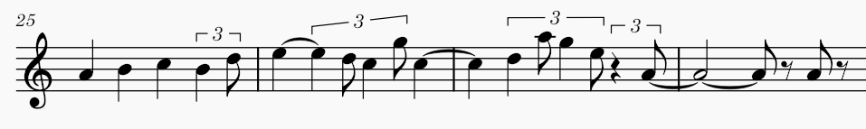
Closeness in Action
Here’s a sample from Mr. PC. The lead looks like this:
And our generated solo looks like this:

Slide 34








Closeness in Action
Here’s a sample from Mr. PC. The lead looks like this:
And our generated solo looks like this:

Slide 35
Changes we would make
Define solo phrases to have specific shapes
Big band version???
Implore music21 developers to include a way of swinging music
Include more edge cases for lead “ingestion”
Taglines, pickups, No Chords, shout sections, rhythm markers, etc.
Jazz is complex and there are no standards for lead sheets

Slide 36
Suggestions for future projects
Don’t. Do. Swing.
More interesting generation algorithms could be cool, a lot of our choices were very “but this sounds better” without consulting mathematics or anything
Or, on the other hand, make good music and focus less on following the algorithm exactly

Slide 37
Thanks! Questions?
Works Cited
J. A. Biles, "GenJam: A Genetic Algorithm for Generating Jazz Solos," in Proc. Int. Comput. Music Conf. (ICMC), Aarhus, Denmark, 1994, pp. 131–137.

